Slide 1
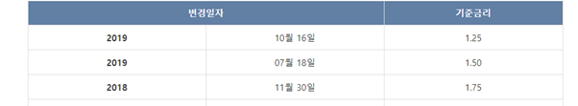
Market interest rate
Trends in base rate
Sources : Bank of korea
Intention : Base rate market rate C, I
Real : Base rate market rate

Slide 2
Market interest rate
The reason why
1. Bond interest rate goes up
2. The regulation at loan to deposit ratio

Slide 3
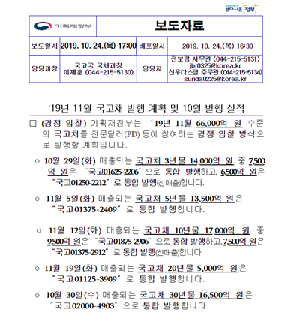
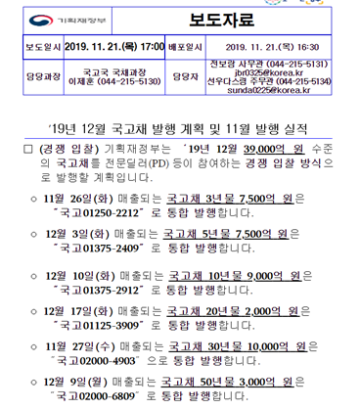
Bond interest
Issuing over 10 trillions of treasury Bonds(국고채)
Sources : Ministry of Economy and Finance(기획재정부)

Slide 4
Bond interest
Increasing Bond interest
Sources : Bank of Korea Economic Statistics System
Korea’s base interest rate was lowered to 1.50 until July 18 at this point.
Despite an additional cut of 1.50 to 1.25 on Oct. 16, treasury bonds are still on the rise.

Slide 5
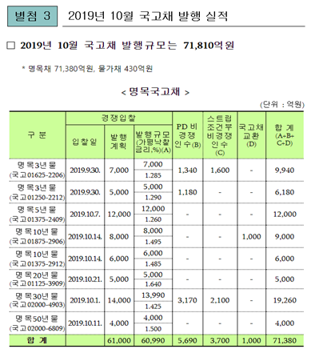
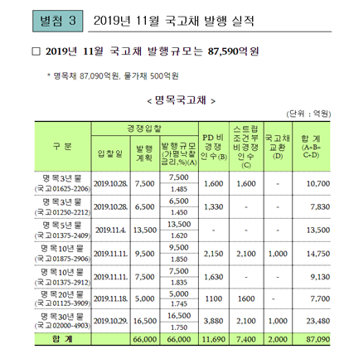
Bond interest
An upward trend in a favorable rate of interest(가평낙찰금리)
Sources : Ministry of Economy and Finance

Slide 6
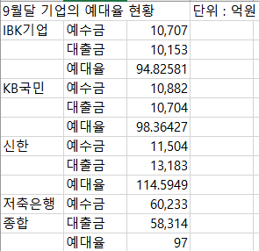
Regulation at loan-deposit ratio
Loan-deposit ratio(예대율) : Important indicator at Bank Management
Generally, 80% is desirable
But, most of Korea’s commercial
Banks’ loan-deposit ratio is around 100%
Sources : Korean Federation of Savings Bank(저축은행중앙회)
Management disclosure by each bank

Slide 7
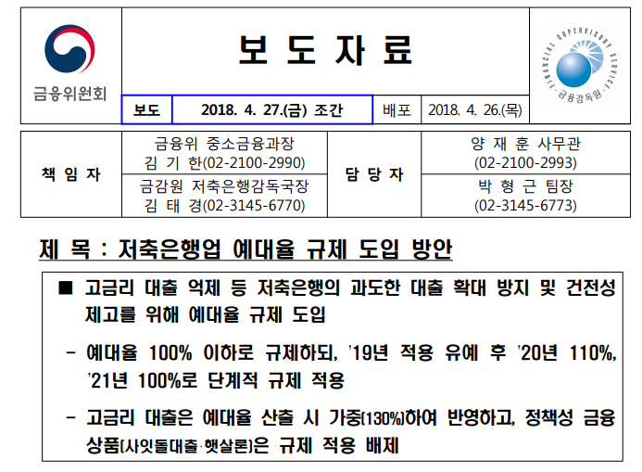
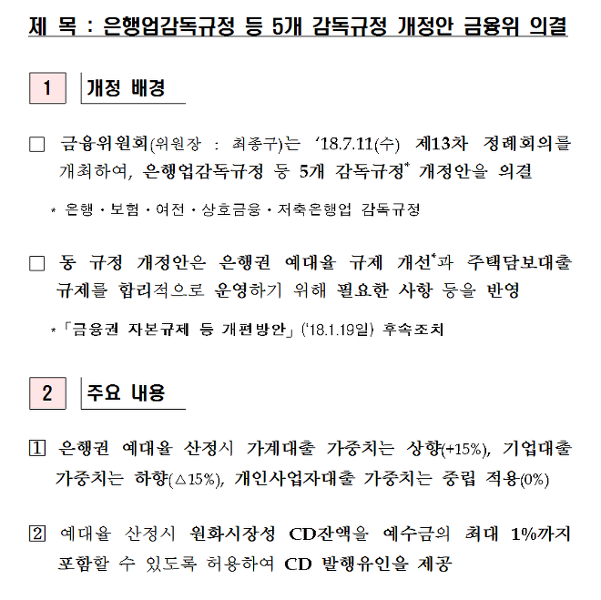
Regulation at loan-deposit ratio
What is detail of Regulation?
Sources : Financial Service Commission(금융위윈회)

Slide 8
Regulation at loan-deposit ratio
Respond by increasing lending interest rate
Sources : The Korean Federation of Banks (은행연합회)

Slide 9


Conclusion
Should look more at the impact of October’s rate cut
Keeping an eye on the situation between US and China
Freeze the base interest rate

